Slide 1
Is God First In Your Life?

Slide 2
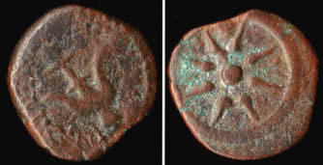
Is God First In YOur Life?
The Widow's Mite
MARK 12:41-44
QUALITY, NOT QUANTITY
ATTITUDE
SACRIFICE
FAITH
THE WIDOW PUT GOD FIRST

Slide 3
Is God First In YOur Life?
The Rich Young Ruler-Matthew 19:16-22
Had a problem with riches
Believed in Jesus
Kept commandments
Couldn't part with his riches
No faith
No sacrifice

Slide 4
Is God First in your life?
Romans 12:1-2, “I beseech you therefore, brethren, by the mercies of God, that you present your bodies a living sacrifice, holy, acceptable to God, which is your reasonable service. And do not be conformed to this world, but be transformed by the renewing of your mind, that you may prove what is that good and acceptable and perfect will of God.”

Slide 5
Is god first in your life?
The Widow and Elijah 1 Kings 17:13-15
Famine
Last Meal
Ready to die
Lack of faith
Listened to God, through Elijah
Had faith
Put God First
Obedience
God's Promise

Slide 6
Is god first in your life?
Meshach, Shadrach and Abednego-Daniel 3:17
Would Not Worship False gods
Had Faith God would deliver them
They Put God First

Slide 7
Is god first in your life?
Mark 12:30 “Love the Lord your God with all your heart and with all your soul and with all your mind and with all your strength.”
Matthew 22:37 “Jesus replied: Love the Lord your God with all your heart and with all your soul and with all your mind.”
John 15:5 “I am the vine, you are the branches; he who abides in Me and I in him, he bears much fruit, for apart from Me you can do nothing.”
John 15:16 “You did not choose me, but I chose you and appointed you that you should go and bear fruit and that your fruit should abide, so that whatever you ask the Father in my name, he may give it to you.”

Slide 8
Is god first in your life?
Galatians 2:20 “I have been crucified with Christ. It is no longer I who live, but Christ who lives in me. And the life I now live in the flesh I live by faith in the Son of God, who loved me and gave himself for me.”
Stay the course
Be Spiritually fit
Spend time in God's Word
Prayer
Like-minded people

Slide 9
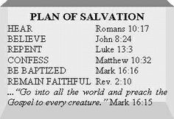
Is god first in your life?
What are you willing to sacrifice for God?

